Slide 1
INTERNET2 Research and Science
Stephen Wolff
Internet2
October 2014

Slide 2
INternet2 research and science
1.0 R&D in support of scholarship
2.0 broadening the remit
3.0 A new initiative
October 16, 2014 © 2013 Internet2

Slide 3
1.0 R&D in support of scholarship
October 16, 2014 © 2013 Internet2

Slide 4
R & D in networking
Drivers –
Support experimental network research
Support proliferating requests for private networks (escaping the curse of Metcalfe’s Law)
More-or-less permanent, for VOs
Ephemeral - even transient - for experiments
Support the increasingly global needs of the Internet2 community – research and education
October 16, 2014 © 2013 Internet2

Slide 5
VO private nets
GENI
XSEDE
PRAGMA
Coming soon –
Chameleon
Cloudlab

Slide 7
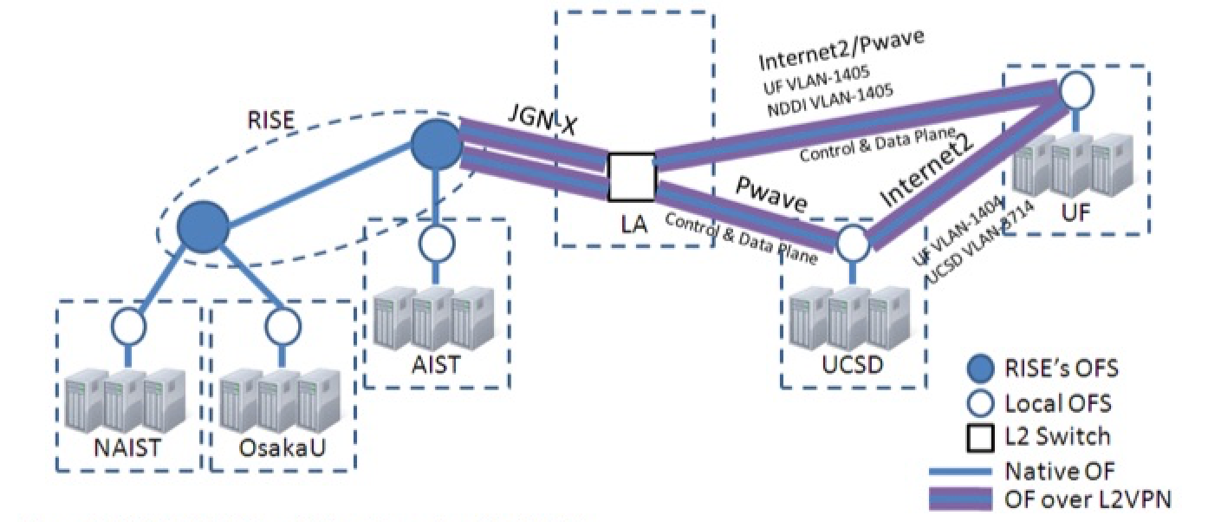
PRAGMA-ENT
October 16, 2014 © 2013 Internet2

Slide 8
R & D in networking
Content-delivery and NDN
SDN – OpenFlow
NFV
SDX and the maturation of GLIF
FTWs / CrossConnects joint with ESnet
October 16, 2014 © 2013 Internet2

Slide 9
R & D in networking
perfSONAR – hardening and development
Merger of MDM and PS forks
Joint project with ESnet and Indiana
perfSONAR at AWS – ESnet, NCBI, Internet2
Interdomain OpenFlow
AutoVFlow
GENI stitching
BGP
WEBridge
…

Slide 10
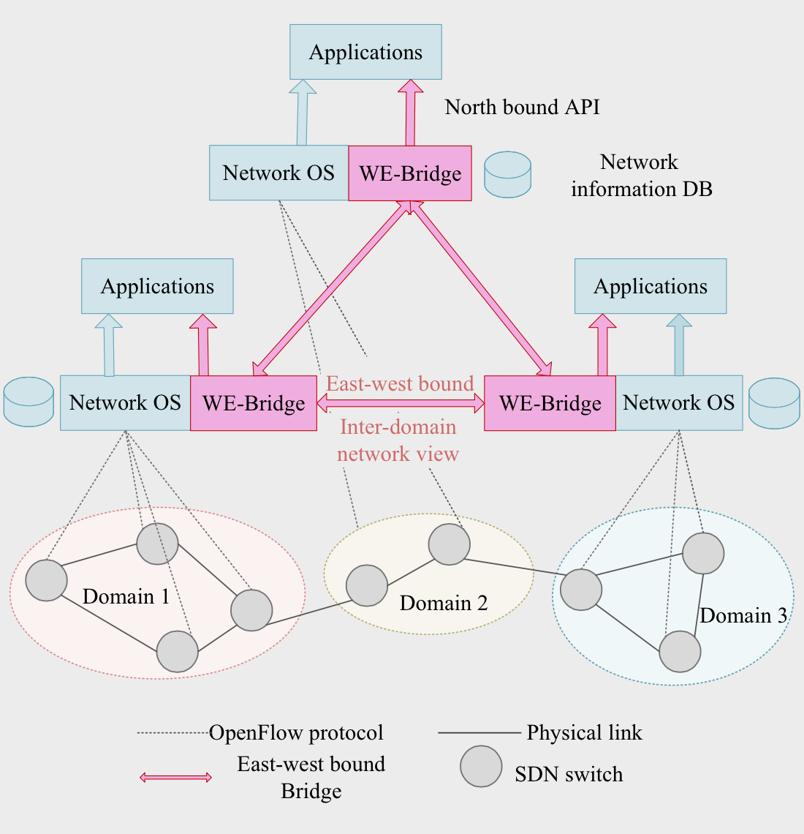
WE-Bridge
October 16, 2014 © 2013 Internet2

Slide 11
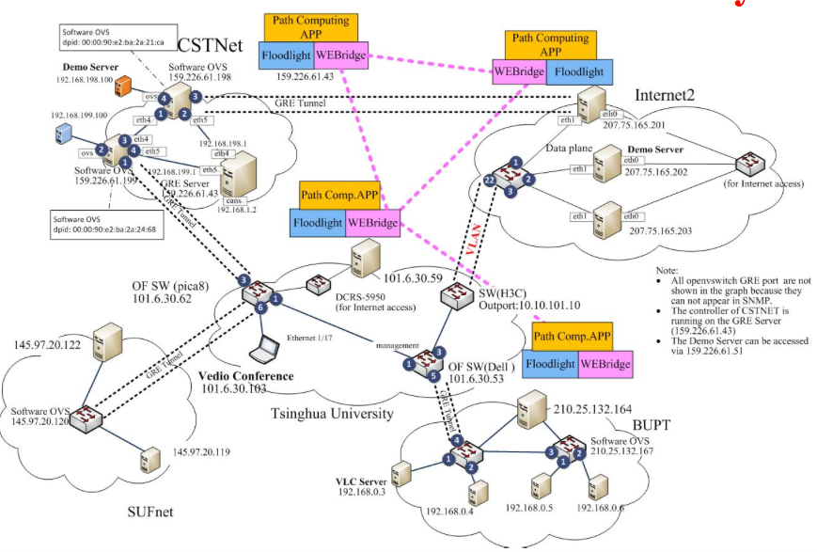
CANS 2014 demo
October 16, 2014 © 2013 Internet2

Slide 12
2.0 broadening the remit
October 16, 2014 © 2013 Internet2

Slide 13
Our beat is the Global R&E Cyberfabric
“Broadening the Reach” – cyberinfrastructure for non-research-intensive schools, including schools in EPSCoR states
NIH AREA, NSF RUI & CAREER, CC*IIE
The long tail of science
Support for research in the life sciences
LSRPAG
ICTBioMed
Increased attention to HPRC
HPRCPAG
RDA – “Data-driven innovation requires a foundation of infrastructure to support the sharing, access, use, re-use, analysis, and stewardship of digital data.”

Slide 14
ICTBioMed
Research cloud for biomedicine
Common software (OpenStack, Galaxy, perfSONAR)
C-DAC | Pune | IN
ACTREC | Navi Mumbai | IN
PSNC | Poznan | PL
Chalmers University | Gothenburg | SE
OHSL | Rockville, MD | US
University of Notre Dame | South Bend, IN | US
Duke University (pending) | Durham, NC | US
Arizona State University (pending) | Phoenix, AZ | US
[ 14 ]
October 16, 2014 © 2013 Internet2
October 16, 2014 © 2013 Internet2

Slide 15
3.0 a new initiative
October 16, 2014 © 2013 Internet2

Slide 16
From NSF award abstracts, 1997:
“NSF, through this program, will provide access for researchers to high performance computing systems, with associated highly trained staff and researchers necessary to develop and optimize their use.”
“NPACI will integrate computational science and engineering education activities into the infrastructure, building on successful education and outreach efforts within the partnership.”

Slide 17
From the Atkins Report*, 2003:
“A new interdisciplinary work force – The need for a new workforce - a new flavor of mixed science and technology professional – is emerging. These individuals have expertise in a particular domain science area, as well as considerable expertise in computer science and mathematics. Also needed in this interdisciplinary mix are professionals who are trained to understand and address the human factors dimensions of working across disciplines, cultures, and institutions using technology-mediated collaboration tools.”
* Revolutionizing Science and Engineering Through Cyberinfrastructure:
Report of the National Science Foundation Blue-Ribbon Advisory Panel
on Cyberinfrastructure, January 2003

Slide 18
We aim to make
“Cyberpractitioner”
a profession.

Slide 19
VSEs
Purpose: Elevate the productivity of the US scientific research enterprise
Vision: Scholars have comprehensive support for compute- and/or data-intensive research, that surpasses in level and accessibility that available today
Strategy: Develop and make available across the domain disciplines a professional cadre of highly skilled cyber-infrastructure practitioner-consultants
Execution: Design, build, and execute a national program to develop the profession as a credentialed academic discipline
[ 19 ]
October 16, 2014 © 2013 Internet2
October 16, 2014 © 2013 Internet2

Slide 20
Characteristics of the profession
Legitimized via “credentialing”
Underlying advancement model
Incorporated in academic and non-academic HR structures
Compensation standards
Incorporated into academic institutional governance
[ 20 ]

Slide 21
Skills/competencies for the profession
Applied mathematics – analysis, statistics, numerical methods, …
Computational skills - programming/scripting, algorithm design, modeling and simulation, workflows / science gateways
Systems architecture
Systems operations – networks, computing, storage, …
Analytics and emerging 4th Paradigm methodology
Communication and people skills – speaking, listening, writing
“T-shaped skillset” – i.e., deep understanding in at least one domain discipline

Slide 22
Core Values
Promote diversity
Professional integrity
Long range view
Life-long learning
Sharing of knowledge and skills
Dynamic and flexible

Slide 23
Program/Project Characteristics
Academic program
Certification/validation services
Internships and residency program(s)
Journal(s)
Professional society
Meetings
[ 23 ]

Slide 24
Contacts
Contributors:
OSG
CASC
Internet2 HPRC PAG
XSEDE
NITRD
ACI-REF
National Labs
Internet2 member schools
Supporters and Sponsors:
NAS / NAE / IOM
OSTP/PITAC
Professional societies – SIAM, ASEE, ACM, IEEE, CRA/CRAW, …
NITRD
Federal science agencies – NSF, NIH, DOE, DOD, DOT, AG, NIST,…
Private industry labs
[ 24 ]

Slide 25

October 16, 2014 © 2013 Internet2

Slide 26
What’s Internet2’s Role?
Market maker for Internet2’s services
Manage the certification/validation service
cf. AAMC
Meeting management
Incubate the professional society
Operate the internship and residency program

Slide 27
Thank you
swolff@internet2.edu
[ 27 ]
October 16, 2014 © 2013 Internet2

